Slide 1

A path towards Circular Economy solutions for post-used packaging in Vietnam
Fausto Tazzi – Vice Chairman PROVN / CEO La Vie – Nestle’ Waters Vietnam
VIETNAM CORPORATE SUSTAINABILITY FORUM 2020
“During the meeting or discussions, the parties shall not enter any discussion, activity or conduct that may infringe any applicable competition law. By way of example, participants shall not discuss, communicate or exchange any commercially sensitive information, including information relating to prices, marketing and advertising strategy, terms of supply, trade programs or distribution strategy”

Slide 2





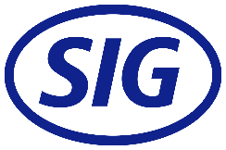





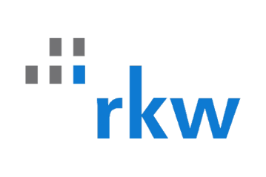


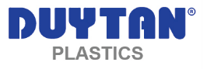
MEMBERS OF PRO VIETNAM
(Associate Members)
(under approval)
(under approval)
Notes:
«ZERO WASTE»
Zero packaging from PRO members will be wasted into the Viet Nam environment by 2030
OR
«ALL RECYCLED»
All packaging from PRO members will be fully recyclable and recovered in Viet Nam by 2030

Slide 3
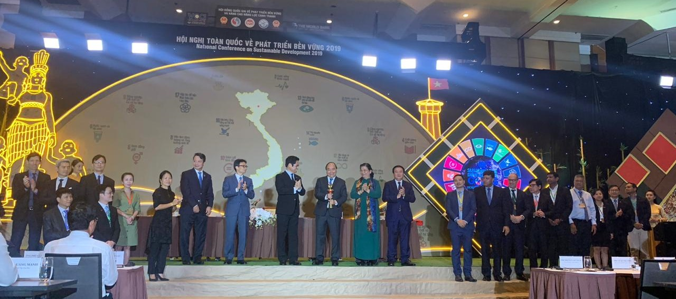
Recognized by PM at National Conference on SD 2019

Slide 4


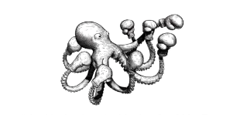









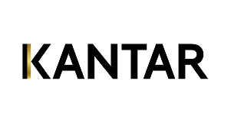
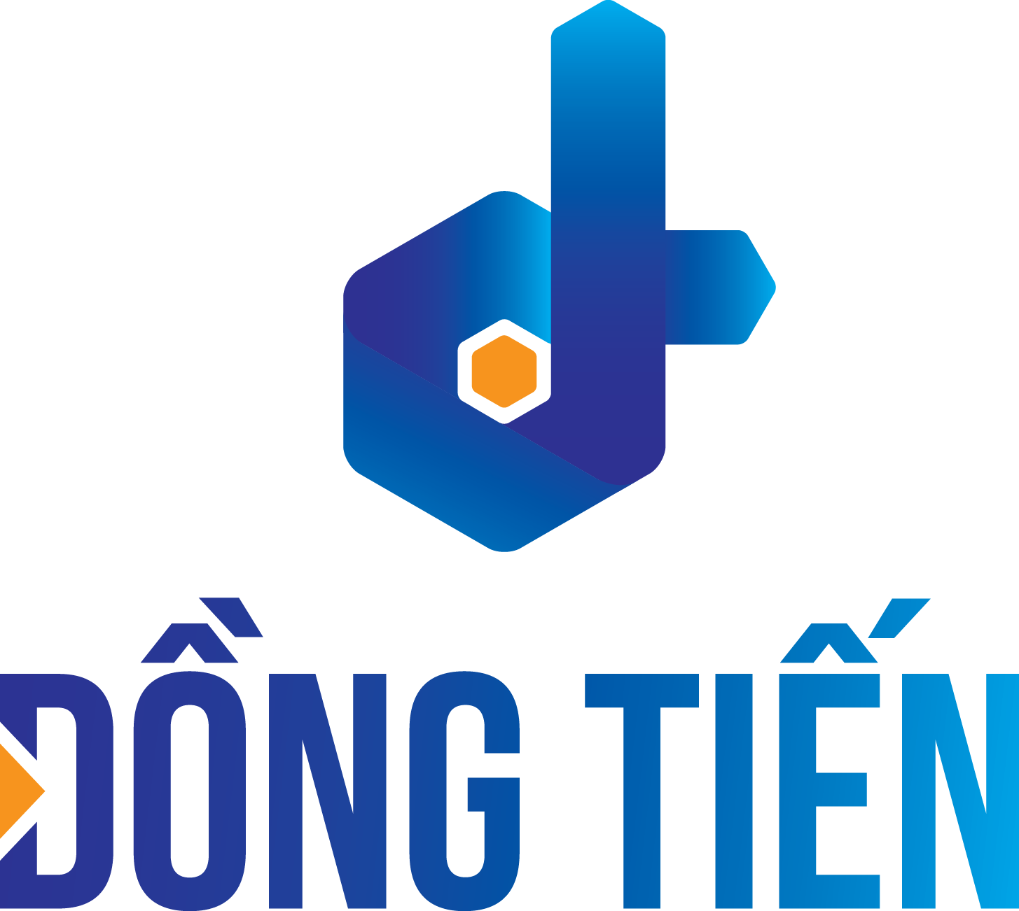









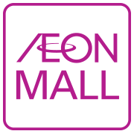



PARTNERS OF PRO VIETNAM
Ongoing talks
STRATEGIC
PARTNERSHIPS
OPERATIONAL
PARTNERSHIPS
MEDIA & COMMUNICATION PARTNERSHIPS
KNOWLEDGE
PARTNERSHIPS
Quang Nam province
Department of Culture, Sport & Tourism
Departmentt of Natural Resources & Environment
Notes:
«ZERO WASTE»
Zero packaging from PRO members will be wasted into the Viet Nam environment by 2030
OR
«ALL RECYCLED»
All packaging from PRO members will be fully recyclable and recovered in Viet Nam by 2030

Slide 5
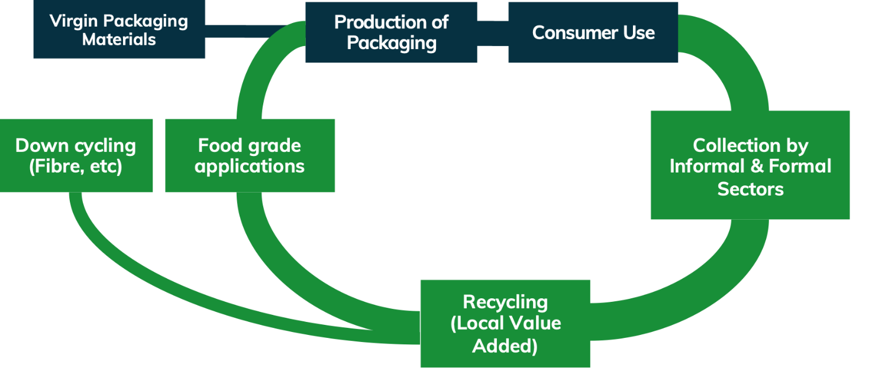
Closing the loop of circular packaging economy in Vietnam
Notes:
«ZERO WASTE»
Zero packaging from PRO members will be wasted into the Viet Nam environment by 2030
OR
«ALL RECYCLED»
All packaging from PRO members will be fully recyclable and recovered in Viet Nam by 2030

Slide 6
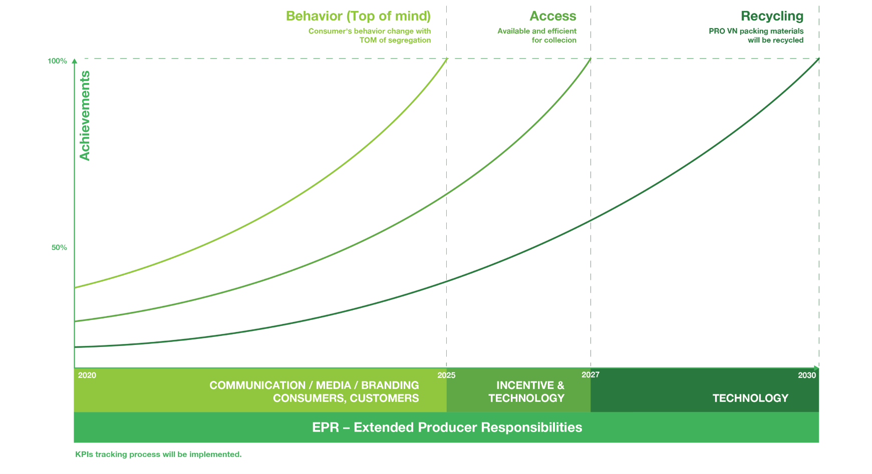
PRO Vietnam Roadmap 2020-2030

Slide 7
PRO Vietnam is
An owner of collected material
An operator of recycling plants and equipments
An operator of waste collection systems, buy-back or drop-off centers
A company with profit as main objective
PRO Vietnam is not
A voluntary industry-driven pre-competitive solution
A professionally run, not-for-profit entity acting as interface between industry, consumers, NGOs and authorities
An enabler of a cost-effective approach, aiming at strengthening existing collection and recovery infrastructures, with the aim to build a recycling ecosystem

Slide 8
The PRO Vietnam narrative
Packaging litter has become an issue in Vietnam which needs to be addressed
We need to come together and work hand in hand for a clean, green and beautiful Vietnam
Recycling is the game changer
Packaging waste is a problem only if mismanaged, ending up in landfill/ocean
Used packaging is not waste but a resource, it can be put to new use
Notes:
Used packaging is not waste - with habit change, technology and circular economy ecosystem it can be put to new use
Recycling is the game changer – we need to come together and work hand in hand for a clean, green and beautiful Vietnam

Slide 9

https://www.youtube.com/watch?v=q0qHbzLmYts&t=6s
Notes:
Must have internet connection to show the clip because this is the link from YouTube.

Slide 10
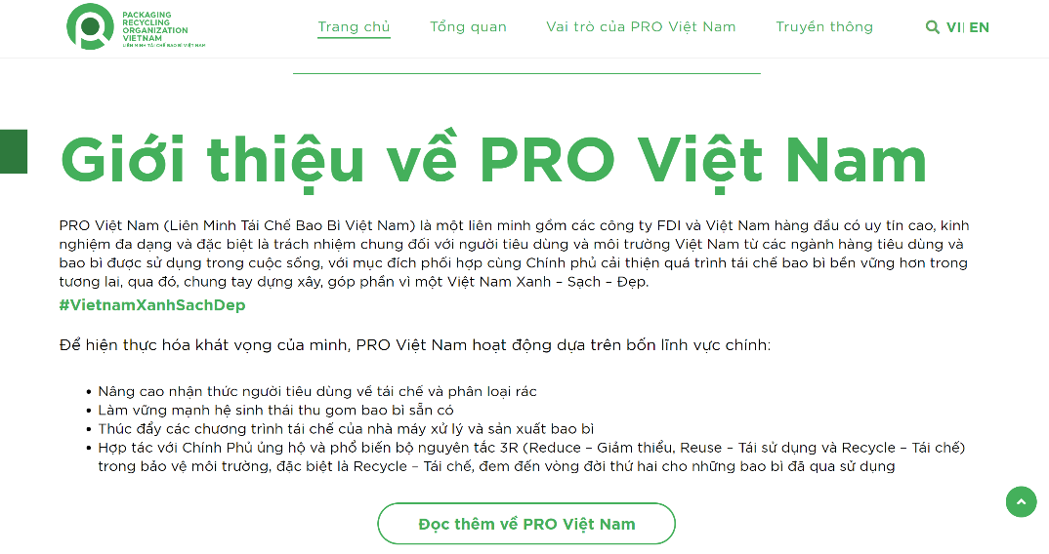
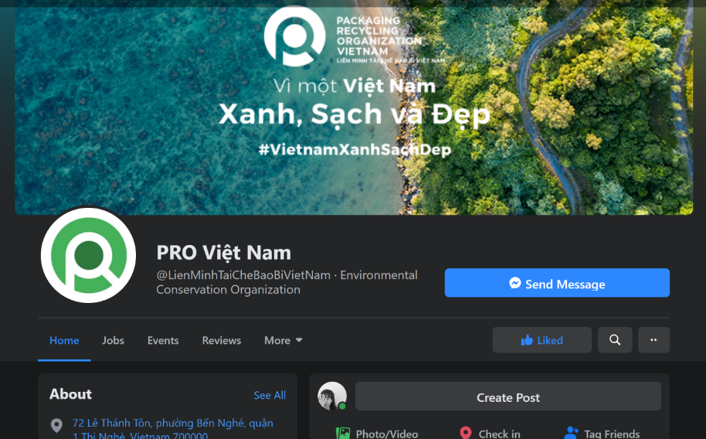
Website
https://provietnam.com.vn/en/home/
Facebook
https://www.facebook.com/LienMinhTaiCheBaoBiVietNam

Slide 11




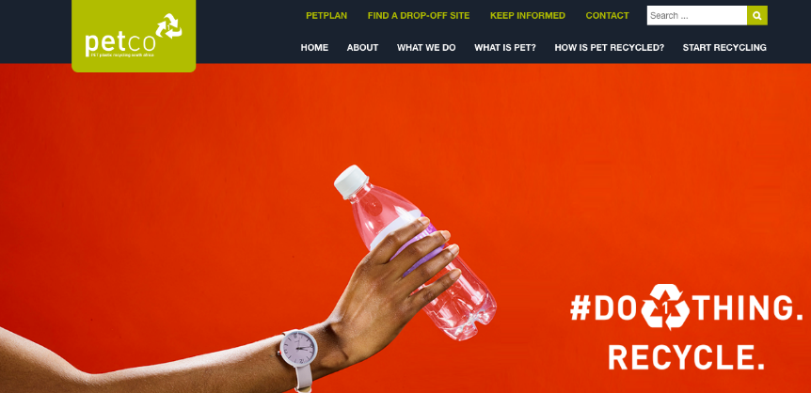
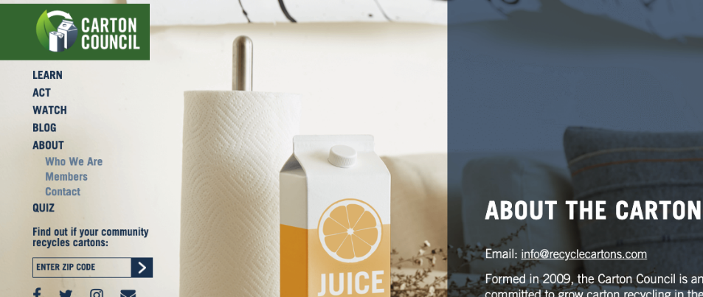
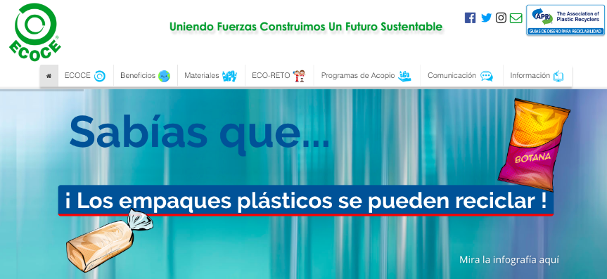


Modeled on similar successful systems
EU / Belgium
South Africa
USA
Mexico

Slide 12
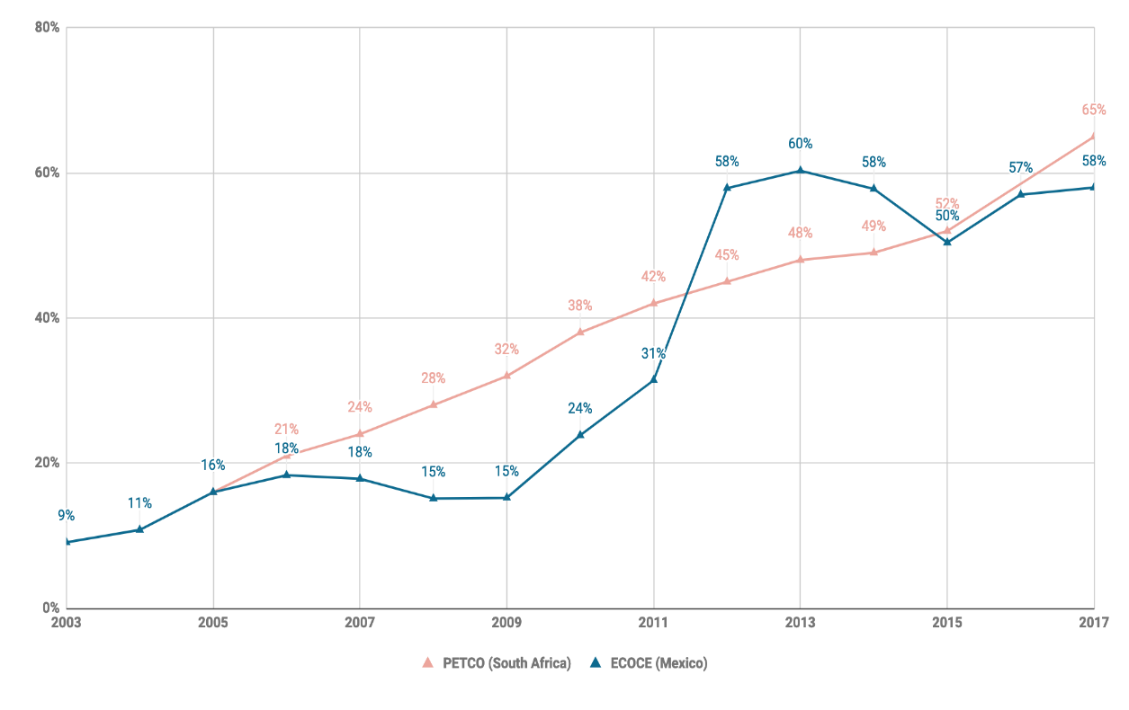
Success stories of PROs in increasing packaging recycling

Slide 13
Two different streams of recyclables
Households /
Bulk Waste Generators
High Value Stream (Minority)
Low Value Stream (Majority)
Has separated recyclables
Recyclables are within mixed waste
collected with mixed waste
Waste Collectors
Recycling Collectors
Waste Collectors
picks out and sells to
Transfer Stations / Collection Points
sells to
mostly sells/gives to
sometimes gives to
Junk Shops
sells to
Material Pickers
Landfill
rarely, sells to
1-10 tons per day
picked out
Aggregators
50 tons per day
Recycling Factories
50-100 tons per day

Slide 14
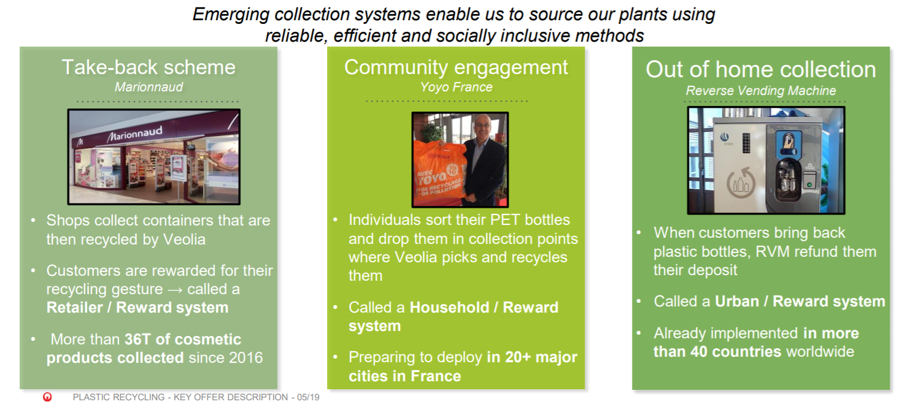
Testing modern collection systems

Slide 15
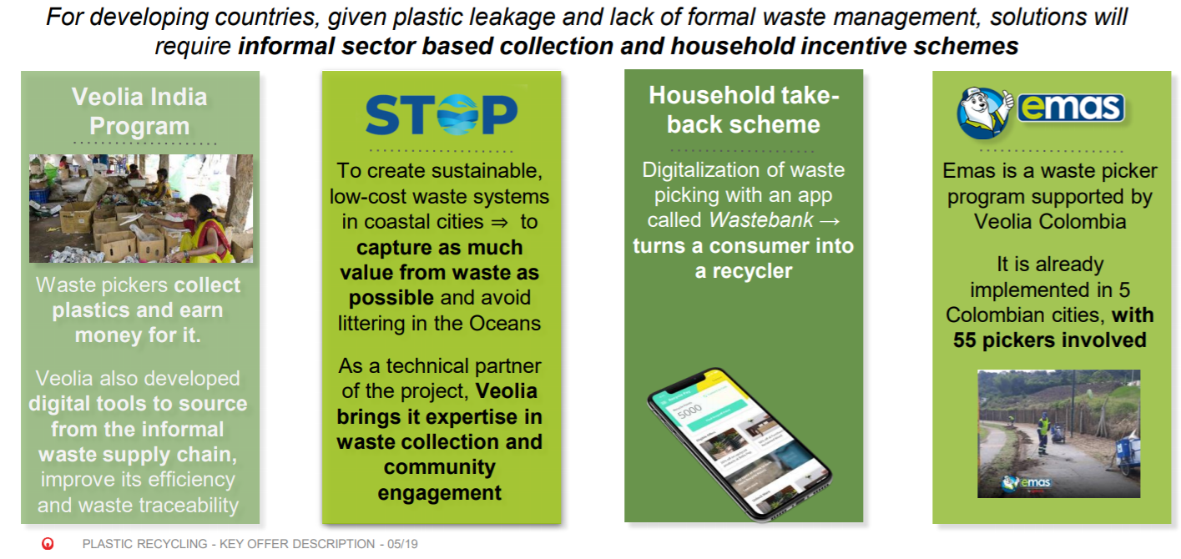
Upgrading traditional collection schemes

Slide 16
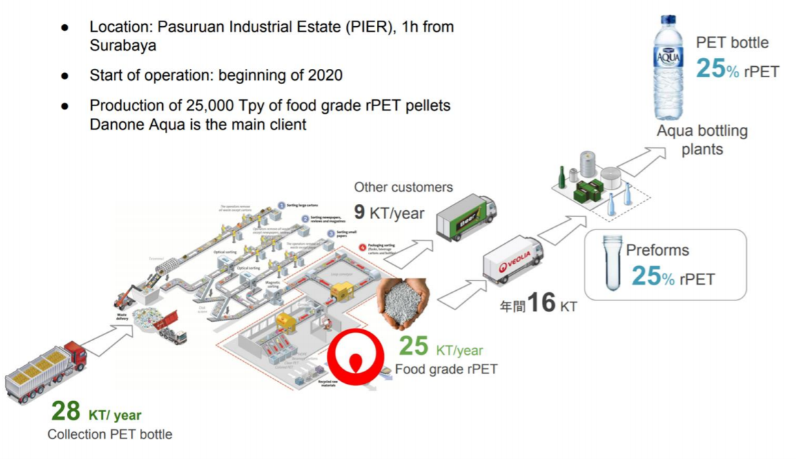
Closing the packaging loop

Slide 17
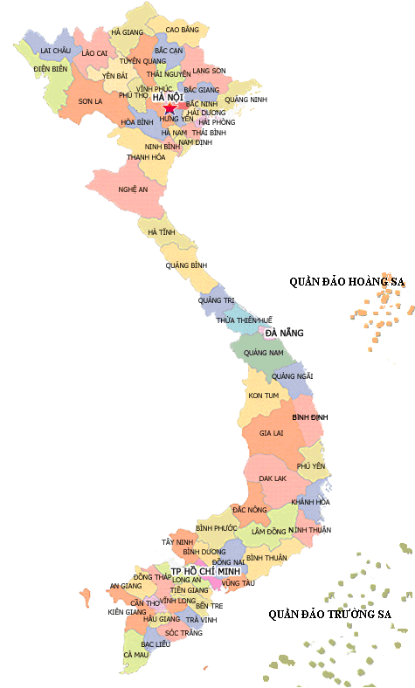
PROVN & EURP – Research on informal sector across Vietnam (Hanoi, HCMC, Buon Me Thuot, Nha Trang) conducted by IRD & Hanoi Architect University
PRO Vietnam Proofs of Concept 2020 - 2021
PROVN & IUCN – Project in Hoi An - scaled up from ReForm Cham Island Landfill Project
PROVN & Veolia – Project in HCMC - setting up a multi-channel system for recyclable wastes
PROVN & WWF – supporting Sustainable Agriculture Club in Phu Quoc island to promote waste segregation at households

